Slide 1
Basic Business Statistics
11th Edition
Chapter 6
The Normal Distribution and Other Continuous Distributions

Slide 2
Learning Objectives
In this chapter, you learn:
To compute probabilities from the normal distribution
To use the normal probability plot to determine whether a set of data is approximately normally distributed
To compute probabilities from the uniform distribution
To compute probabilities from the exponential distribution
To compute probabilities from the normal distribution to approximate probabilities from the binomial distribution

Slide 3
Continuous Probability Distributions
A continuous random variable is a variable that can assume any value on a continuum (can assume an uncountable number of values)
  thickness of an item
  time required to complete a task
  temperature of a solution
  height, in inches
These can potentially take on any value depending only on the ability to precisely and accurately measure

Slide 4
The Normal Distribution
‘Bell Shaped’
Symmetrical
Mean, Median and Mode
are Equal
Location is determined by the mean, μ
Spread is determined by the standard deviation, σ
The random variable has an infinite theoretical range:
+ ∞ to − ∞
f(X)
σ
X
μ
Mean
= Median
= Mode

Slide 5
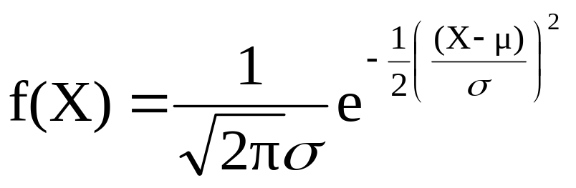
The Normal Distribution
Density Function
The formula for the normal probability density function is
Where e = the mathematical constant approximated by 2.71828
π = the mathematical constant approximated by 3.14159
μ = the population mean
σ = the population standard deviation
X = any value of the continuous variable

Slide 6
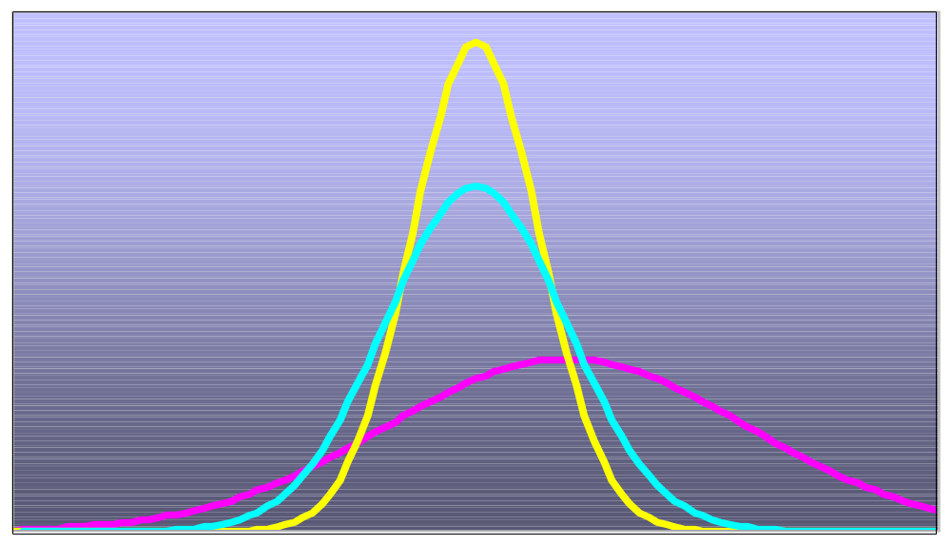
Many Normal Distributions
By varying the parameters μ and σ, we obtain different normal distributions

Slide 7
The Normal Distribution Shape
f(X)
Changing μ shifts the distribution left or right.
Changing σ increases or decreases the spread.
σ
μ
X

Slide 8
The Standardized Normal
Any normal distribution (with any mean and standard deviation combination) can be transformed into the standardized normal distribution (Z)
Need to transform X units into Z units
The standardized normal distribution (Z) has a mean of 0 and a standard deviation of 1

Slide 9
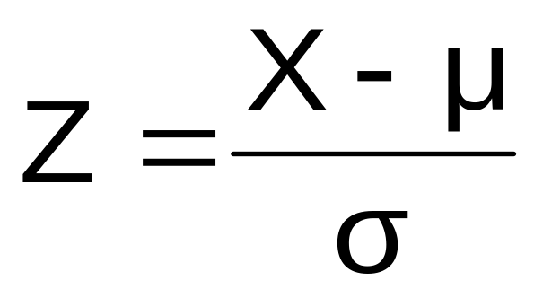
Translation to the Standardized Normal Distribution
Translate from X to the standardized normal (the “Z” distribution) by subtracting the mean of X and dividing by its standard deviation:
The Z distribution always has mean = 0 and standard deviation = 1

Slide 10
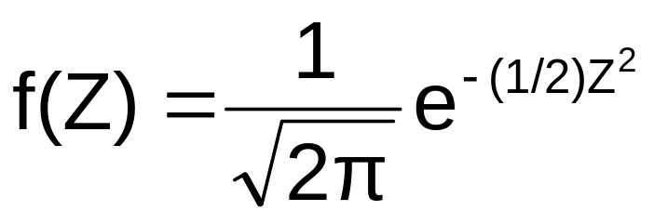
The Standardized Normal Probability Density Function
The formula for the standardized normal probability density function is
Where e = the mathematical constant approximated by 2.71828
π = the mathematical constant approximated by 3.14159
Z = any value of the standardized normal distribution

Slide 11
The Standardized
Normal Distribution
Also known as the “Z” distribution
Mean is 0
Standard Deviation is 1
f(Z)
1
Z
0
Values above the mean have positive Z-values, values below the mean have negative Z-values

Slide 12
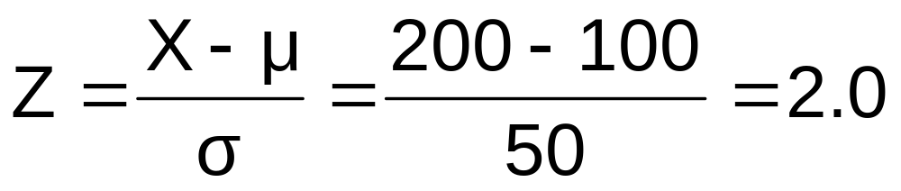
Example
If X is distributed normally with mean of 100 and standard deviation of 50, the Z value for X = 200 is
This says that X = 200 is two standard deviations (2 increments of 50 units) above the mean of 100.

Slide 13
Comparing X and Z units
100
200
X
(μ = 100, σ = 50)
0
2.0
Z
(μ = 0, σ = 1)
Note that the shape of the distribution is the same, only the scale has changed. We can express the problem in original units (X) or in standardized units (Z)

Slide 14
Finding Normal Probabilities
Probability is measured by the area under the curve
f(X)
P
(
≤
≤
)
a
X
b
=
P
(
<
<
)
a
X
b
(Note that the probability of any individual value is zero)
a
b
X

Slide 15


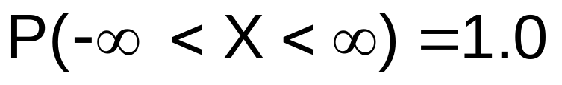
Probability as
Area Under the Curve
The total area under the curve is 1.0, and the curve is symmetric, so half is above the mean, half is below
f(X)
0.5
0.5
μ
X

Slide 16
The Standardized Normal Table
The Cumulative Standardized Normal table in the textbook (Appendix table E.2) gives the probability less than a desired value of Z (i.e., from negative infinity to Z)
0.9772
Example:
P(Z < 2.00) = 0.9772
0
2.00
Z

Slide 17
The Standardized Normal Table
(continued)
The column gives the value of Z to the second decimal point
Z 0.00 0.01 0.02 …
0.0
0.1
The row shows the value of Z to the first decimal point
.
.
.
The value within the table gives the probability from Z = − ∞ up to the desired Z value
2.0
.9772
P(Z < 2.00) = 0.9772
2.0

Slide 18
General Procedure for Finding Normal Probabilities
To find P(a < X < b) when X is distributed normally:
Draw the normal curve for the problem in
terms of X
Translate X-values to Z-values
Use the Standardized Normal Table

Slide 19
Finding Normal Probabilities
Let X represent the time it takes to download an image file from the internet.
Suppose X is normal with mean 8.0 and standard deviation 5.0. Find P(X < 8.6)
X
8.0
8.6

Slide 20
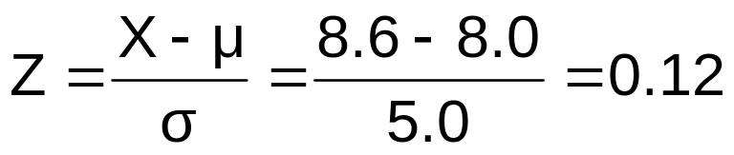
Finding Normal Probabilities
(continued)
Let X represent the time it takes to download an image file from the internet.
Suppose X is normal with mean 8.0 and standard deviation 5.0. Find P(X < 8.6)
μ = 8
σ = 10
μ = 0
σ = 1
8
8.6
X
0
0.12
Z
P(X < 8.6)
P(Z < 0.12)

Slide 21
Solution: Finding P(Z < 0.12)
Standardized Normal Probability
Table (Portion)
P(X < 8.6)
= P(Z < 0.12)
Z
.00
.01
.02
.5478
0.0
.5000
.5040
.5080
0.1
.5398
.5438
.5478
0.2
.5793
.5832
.5871
Z
0.3
.6179
.6217
.6255
0.00
0.12

Slide 22
Finding Normal
Upper Tail Probabilities
Suppose X is normal with mean 8.0 and standard deviation 5.0.
Now Find P(X > 8.6)
X
8.0
8.6

Slide 23
Finding Normal
Upper Tail Probabilities
(continued)
Now Find P(X > 8.6)…
P(X > 8.6) = P(Z > 0.12) = 1.0 - P(Z ≤ 0.12)
= 1.0 - 0.5478 = 0.4522
0.5478
1.000
1.0 - 0.5478 = 0.4522
Z
Z
0
0
0.12
0.12

Slide 24
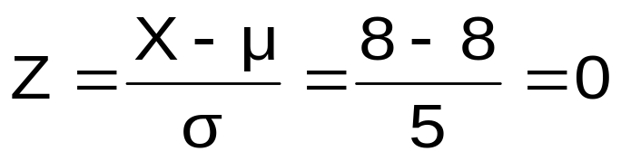
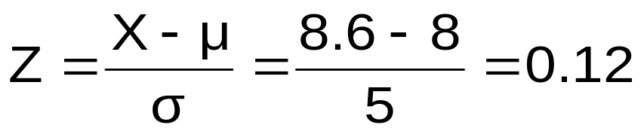
Finding a Normal Probability Between Two Values
Suppose X is normal with mean 8.0 and standard deviation 5.0. Find P(8 < X < 8.6)
Calculate Z-values:
8
8.6
X
0
0.12
Z
P(8 < X < 8.6)
= P(0 < Z < 0.12)

Slide 25
Solution: Finding P(0 < Z < 0.12)
P(8 < X < 8.6)
Standardized Normal Probability
Table (Portion)
= P(0 < Z < 0.12)
= P(Z < 0.12) – P(Z ≤ 0)
Z
.00
.01
.02
= 0.5478 - .5000 = 0.0478
0.0
.5000
.5040
.5080
0.0478
0.5000
0.1
.5398
.5438
.5478
0.2
.5793
.5832
.5871
0.3
.6179
.6217
.6255
Z
0.00
0.12

Slide 26
Probabilities in the Lower Tail
Suppose X is normal with mean 8.0 and standard deviation 5.0.
Now Find P(7.4 < X < 8)
X
8.0
7.4

Slide 27
Probabilities in the Lower Tail
(continued)
Now Find P(7.4 < X < 8)…
P(7.4 < X < 8)
= P(-0.12 < Z < 0)
= P(Z < 0) – P(Z ≤ -0.12)
= 0.5000 - 0.4522 = 0.0478
0.0478
0.4522
The Normal distribution is symmetric, so this probability is the same as P(0 < Z < 0.12)
7.4
8.0
X
-0.12
0
Z

Slide 28
Empirical Rules
What can we say about the distribution of values around the mean? For any normal distribution:
f(X)
μ ± 1σ encloses about 68.26% of X’s
σ
σ
X
μ-1σ
μ
μ+1σ
68.26%

Slide 29
The Empirical Rule
(continued)
μ ± 2σ covers about 95% of X’s
μ ± 3σ covers about 99.7% of X’s
2σ
2σ
3σ
3σ
μ
x
μ
x
95.44%
99.73%

Slide 30
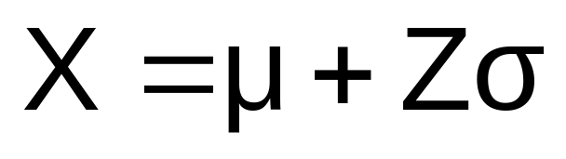
Given a Normal Probability
Find the X Value
Steps to find the X value for a known probability:
1. Find the Z value for the known probability
2. Convert to X units using the formula:

Slide 31
Finding the X value for a Known Probability
(continued)
Example:
Let X represent the time it takes (in seconds) to download an image file from the internet.
Suppose X is normal with mean 8.0 and standard deviation 5.0
Find X such that 20% of download times are less than X.
0.2000
?
8.0
X
?
0
Z

Slide 32
Find the Z value for
20% in the Lower Tail
1. Find the Z value for the known probability
Standardized Normal Probability
Table (Portion)
20% area in the lower tail is consistent with a Z value of -0.84
Z
…
.03
.04
.05
-0.9
…
.1762
.1736
.1711
0.2000
-0.8
…
.2033
.2005
.1977
-0.7
…
.2327
.2296
.2266
?
8.0
X
-0.84
0
Z

Slide 33
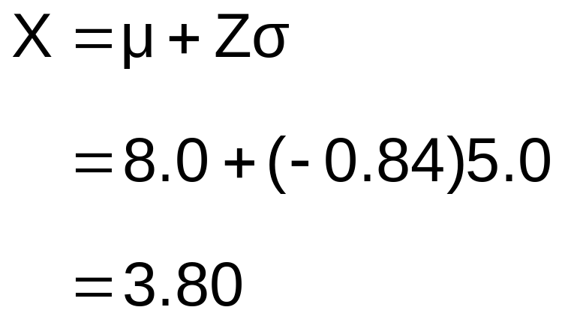
Finding the X value
2. Convert to X units using the formula:
So 20% of the values from a distribution with mean 8.0 and standard deviation 5.0 are less than 3.80

Slide 34
Evaluating Normality
Not all continuous distributions are normal
It is important to evaluate how well the data set is approximated by a normal distribution.
Normally distributed data should approximate the theoretical normal distribution:
  The normal distribution is bell shaped (symmetrical) where the mean is equal to the median.
  The empirical rule applies to the normal distribution.
  The interquartile range of a normal distribution is 1.33 standard deviations.

Slide 35
Evaluating Normality
(continued)
Comparing data characteristics to theoretical properties
Construct charts or graphs
  For small- or moderate-sized data sets, construct a stem-and-leaf display or a boxplot to check for symmetry
  For large data sets, does the histogram or polygon appear bell-shaped?
Compute descriptive summary measures
  Do the mean, median and mode have similar values?
  Is the interquartile range approximately 1.33 σ?
  Is the range approximately 6 σ?

Slide 36
Evaluating Normality
(continued)
Comparing data characteristics to theoretical properties
Observe the distribution of the data set
  Do approximately 2/3 of the observations lie within mean ±1 standard deviation?
  Do approximately 80% of the observations lie within mean ±1.28 standard deviations?
  Do approximately 95% of the observations lie within mean ±2 standard deviations?
Evaluate normal probability plot
  Is the normal probability plot approximately linear (i.e. a straight line) with positive slope?

Slide 37
Constructing
A Normal Probability Plot
Normal probability plot
  Arrange data into ordered array
  Find corresponding standardized normal quantile values (Z)
  Plot the pairs of points with observed data values (X) on the vertical axis and the standardized normal quantile values (Z) on the horizontal axis
  Evaluate the plot for evidence of linearity

Slide 38
The Normal Probability Plot
Interpretation
A normal probability plot for data from a normal distribution will be approximately linear:
X
90
60
30
-2
-1
0
1
2
Z

Slide 39
Normal Probability Plot
Interpretation
(continued)
Left-Skewed
Right-Skewed
X
90
X
90
60
60
30
30
-2
-1
0
1
2
Z
-2
-1
0
1
2
Z
Rectangular
Nonlinear plots indicate a deviation from normality
X
90
60
30
-2
-1
0
1
2
Z

Slide 40
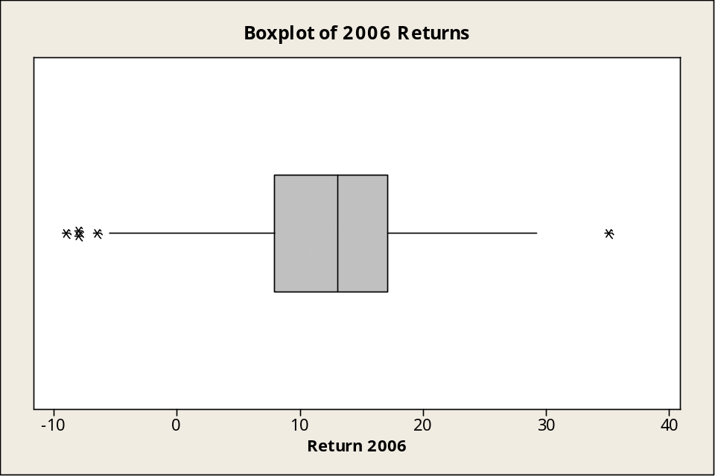
Evaluating Normality
An Example: Mutual Funds Returns
The boxplot appears reasonably symmetric, with three lower outliers at -9.0, -8.0, and -8.0 and one upper outlier at 35.0. (The normal distribution is symmetric.)

Slide 41
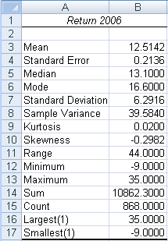
Evaluating Normality
An Example: Mutual Funds Returns
(continued)
Descriptive Statistics
The mean (12.5142) is slightly less than the median (13.1). (In a normal distribution the mean and median are equal.)
The interquartile range of 9.2 is approximately 1.46 standard deviations. (In a normal distribution the interquartile range is 1.33 standard deviations.)
The range of 44 is equal to 6.99 standard deviations. (In a normal distribution the range is 6 standard deviations.)
72.2% of the observations are within 1 standard deviation of the mean. (In a normal distribution this percentage is 68.26%.
87% of the observations are within 1.28 standard deviations of the mean. (In a normal distribution percentage is 80%.)

Slide 42
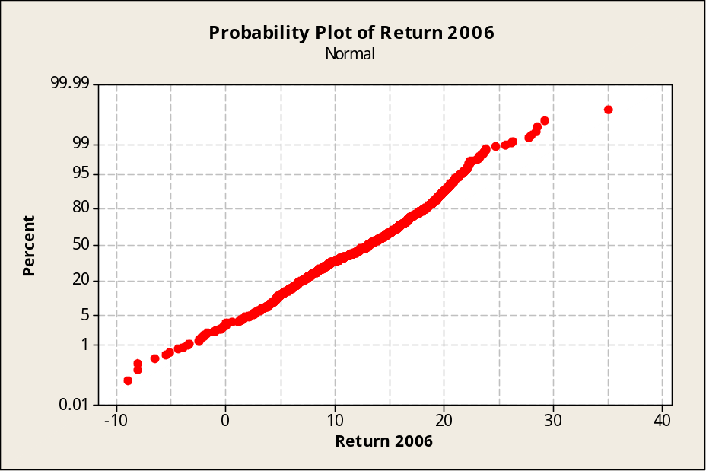
Evaluating Normality
An Example: Mutual Funds Returns
(continued)
Plot is approximately a straight line except for a few outliers at the low end and the high end.

Slide 43
Evaluating Normality
An Example: Mutual Funds Returns
(continued)
Conclusions
  The returns are slightly left-skewed
  The returns have more values concentrated around the mean than expected
  The range is larger than expected (caused by one outlier at 35.0)
  Normal probability plot is reasonably straight line
  Overall, this data set does not greatly differ from the theoretical properties of the normal distribution

Slide 44
The Uniform Distribution
The uniform distribution is a probability distribution that has equal probabilities for all possible outcomes of the random variable
Also called a rectangular distribution

Slide 45
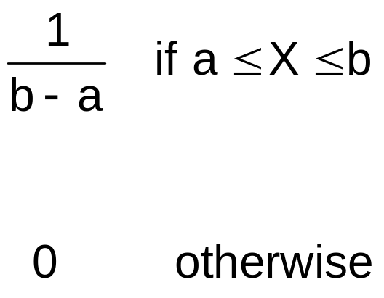
The Uniform Distribution
(continued)
The Continuous Uniform Distribution:
f(X) =
where
f(X) = value of the density function at any X value
a = minimum value of X
b = maximum value of X

Slide 46
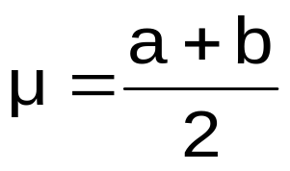
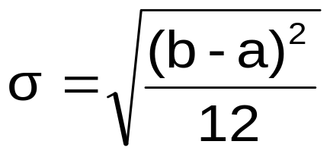
Properties of the
Uniform Distribution
The mean of a uniform distribution is
The standard deviation is

Slide 47
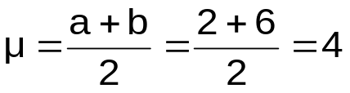
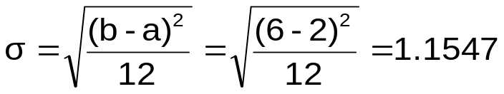
Uniform Distribution Example
Example: Uniform probability distribution
over the range 2 ≤ X ≤ 6:
1
f(X) = = 0.25 for 2 ≤ X ≤ 6
6 - 2
f(X)
0.25
2
6
X

Slide 48
Uniform Distribution Example
(continued)
Example: Using the uniform probability distribution to find P(3 ≤ X ≤ 5):
P(3 ≤ X ≤ 5) = (Base)(Height) = (2)(0.25) = 0.5
f(X)
0.25
2
3
4
5
6
X

Slide 49
The Exponential Distribution
Often used to model the length of time between two occurrences of an event (the time between arrivals)
  Examples:
    Time between trucks arriving at an unloading dock
    Time between transactions at an ATM Machine
    Time between phone calls to the main operator

Slide 50
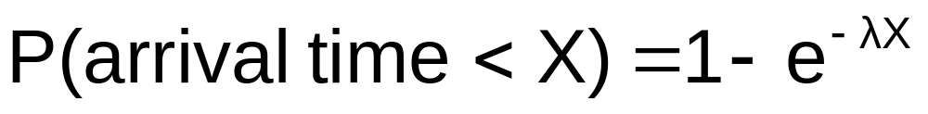

The Exponential Distribution
Defined by a single parameter, its mean λ (lambda)
The probability that an arrival time is less than some specified time X is
where e = mathematical constant approximated by 2.71828
λ = the population mean number of arrivals per unit
X = any value of the continuous variable where 0 < X <

Slide 51
Exponential Distribution
Example
Example: Customers arrive at the service counter at the rate of 15 per hour. What is the probability that the arrival time between consecutive customers is less than three minutes?
The mean number of arrivals per hour is 15, so λ = 15
Three minutes is 0.05 hours
P(arrival time < .05) = 1 – e^{-λX} = 1 – e^{-(15)(0.05)} = 0.5276
So there is a 52.76% probability that the arrival time between successive customers is less than three minutes

Slide 52
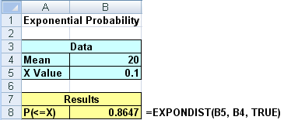
The Exponential Distribution
In Excel
Calculating the probability that an exponential distribution with an mean of 20 is less than 0.1

Slide 53
Normal Approximation to the Binomial Distribution
The binomial distribution is a discrete distribution, but the normal is continuous
To use the normal to approximate the binomial, accuracy is improved if you use a correction for continuity adjustment
Example:
  X is discrete in a binomial distribution, so P(X = 4) can be approximated with a continuous normal distribution by finding
  P(3.5 < X < 4.5)

Slide 54
Normal Approximation to the Binomial Distribution
(continued)
The closer π is to 0.5, the better the normal approximation to the binomial
The larger the sample size n, the better the normal approximation to the binomial
General rule:
  The normal distribution can be used to approximate the binomial distribution if
  nπ ≥ 5
  and
  n(1 – π) ≥ 5

Slide 55
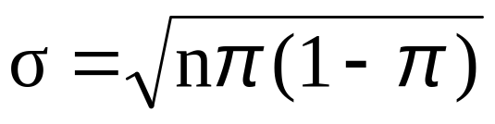
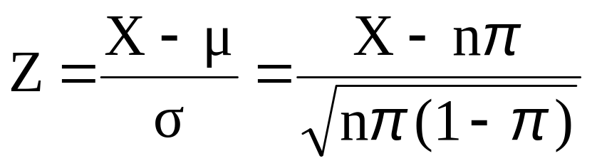
Normal Approximation to the Binomial Distribution
(continued)
The mean and standard deviation of the binomial distribution are
μ = nπ
Transform binomial to normal using the formula:

Slide 56
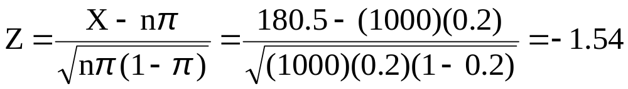
Using the Normal Approximation to the Binomial Distribution
If n = 1000 and π = 0.2, what is P(X ≤ 180)?
Approximate P(X ≤ 180) using a continuity correction adjustment:
P(X ≤ 180.5)
Transform to standardized normal:
So P(Z ≤ -1.54) = 0.0618
180.5
200
X
-1.54
0
Z

Slide 57
Chapter Summary
Presented key continuous distributions
  normal, uniform, exponential
Found probabilities using formulas and tables
Recognized when to apply different distributions
Applied distributions to decision problems

